Slide 1

CALMIFY- A Stress and Anxiety Manager
Ananya Dongare- 23106024
Arya Ghole -23106035
Kimaya Kanyalkar- 23106007
Aparajit Aherkar - 23106131
Project Guide
Ms. Vijaya Jagan
Notes:
1

Slide 2
Introduction
Stress and anxiety are natural responses to challenging situations, but when they
become chronic, they can lead to severe health complications such as depression,
cardiovascular diseases, weakened immune systems, and cognitive impairments
Calmify is a wellness platfrom offering stress-relief therapies like yoga,
audio, reading,Mental Health along with doctor consultations and our 24x7 chatbot.
The mission of the calmify project is to provide accessible and effective stress- relief solutions through various therapies, promoting mental well-being for people of all ages. It aims to create a supportive community by offering resources like yoga, meditation and professional consultations
Notes:
2

Slide 3
Limitation of the Existing System
Headspace & Calm (Popular meditation and mindfulness apps)
Limitation: Lack of personalization; generic content that may not cater to
individual stress-relief needs.
Better Help & Talkspace
Limitation: Paid subscription required for therapy, making it less accessible to
many users.
Sanvello & Moodfit
Limitation: Focus heavily on self-tracking and cognitive exercises, which may
not be engaging for all users
Notes:
3

Slide 4
Problem statement
Rising Stress Issues: People struggle with stress in daily life.
Limited Free Mental Health Support: Many platforms require paid access.
One-Size-Fits-All Approach: Existing solutions lack personalization.
Low User Engagement: Apps fail to keep users consistently involved.
Missing Holistic Therapies: Existing systems ignore audio, reading, and
spiritual healing.
Calmify solves these problems with diverse, engaging, and free stress-relief
options.

Slide 5
Literature Survey
Research Paper | Summary | Key Factors
“Managing Anxiety and Stress Holistically: Vedic Wisdom from the Purna Health Management System” | Determine which of four key factors correlate with participants' overall stress levels, stress management abilities, and mental/emotional health outcomes | 1.Health, Fitness, and Nutrition (HF&N) 2.Life Balance 3.Spiritual Growth and Development (SG&D) 4.Living in Harmony with the Natural Environment to Support Health (LHWNE):
"Stress and Epilepsy: Towards Understanding of Neurobiological Mechanisms for Better Management” | Explains importance of integrated management approaches to improve outcomes for individuals affected by both conditions. | 1.Impact of Stress on Epilepsy 2.Neurobiological Mechanisms

Slide 6
Literature Survey
Research Paper | Summary | Key Factors
"A Systematic Review of Technology-Aided Stress Management | Provides a comprehensive analysis of technological tools utilized in stress management, with a particular focus on feedback control systems encompassing detection, control, and intervention phases. | Physiological Variables Intervention Techniques Feedback Control System
"Mobile Applications for stress management". | The authors highlight that traditional methods for stress reduction include counseling, training, and exercise. However, with technological advancements, mobile applications have emerged as innovative tools for stress management. | 1.Accessibility and Convenience 2.Diverse Techniques 3.Personalization

Slide 7
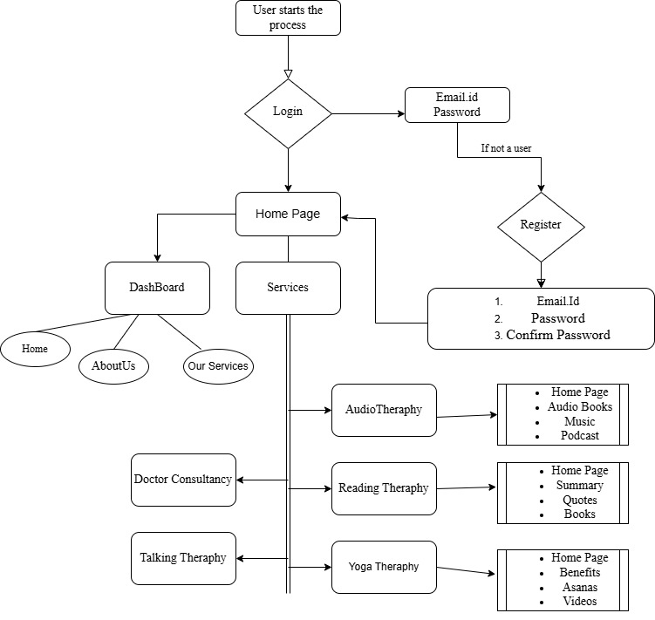
System Design
Notes:
7

Slide 8
Technologies and Methodologies
Technology Stack
Frontend: HTML, CSS, JavaScript
Backend: Xamp , PHP(Hyper Text Pre-processor)
Methodologies
Problem Identification – Identified the need for free, personalized stress management.
Requirement Analysis – Defined key features like therapy
options and consultations.
Technology Selection – Used HTML, CSS, Javascript (Frontend), Xamp,PHP
(Backend),local storage(hosting)
System Design – Developed a user-friendly interface and structured backend.
Implementation – Integrated therapy modules, consultations,
Notes:
8

Slide 9
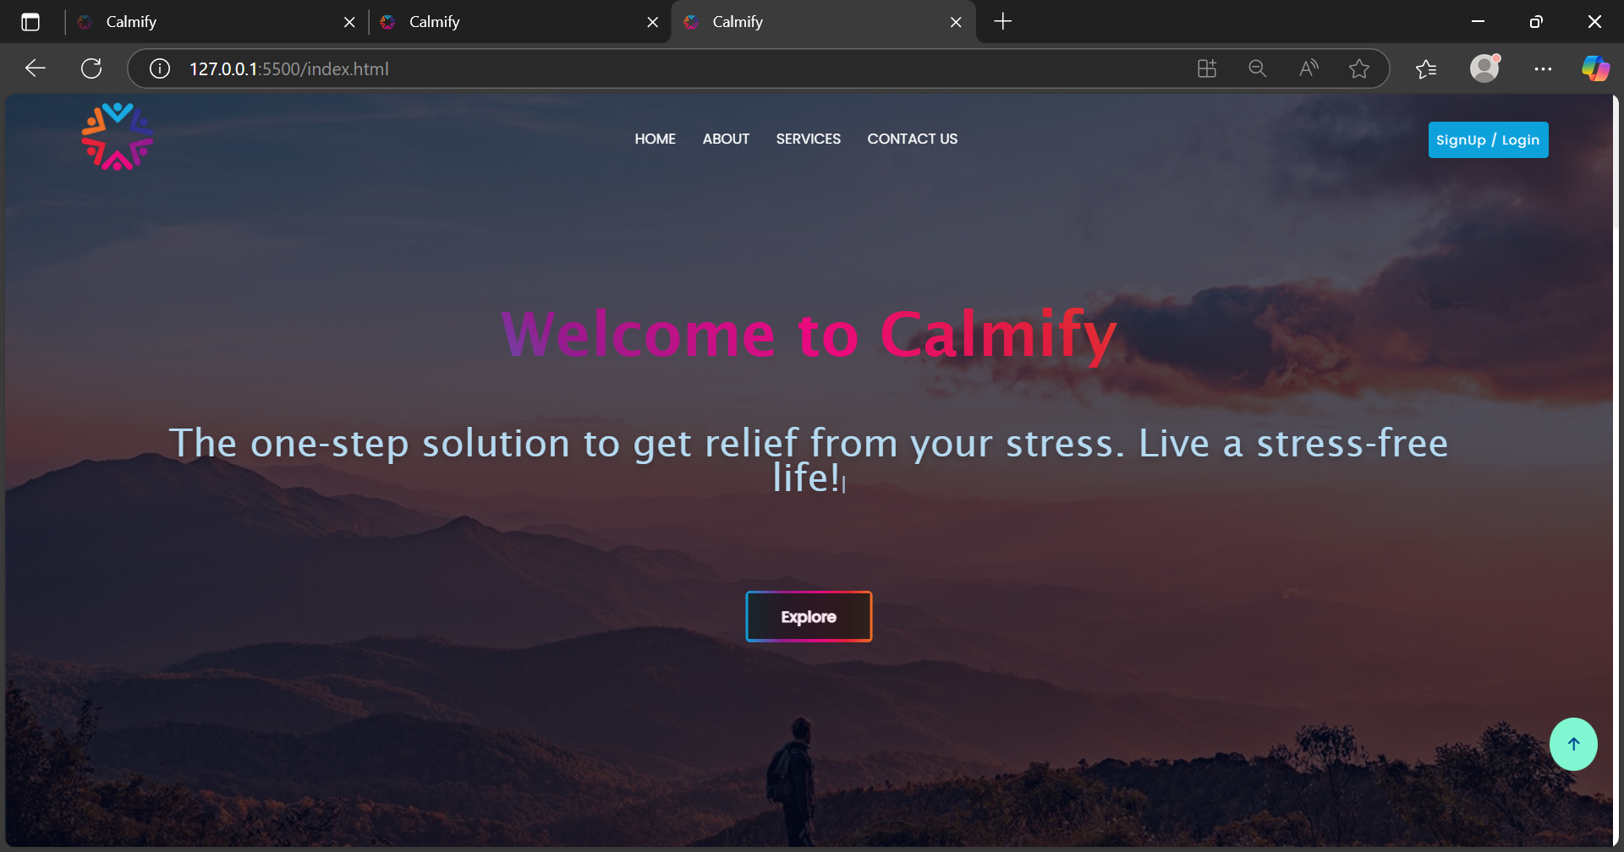
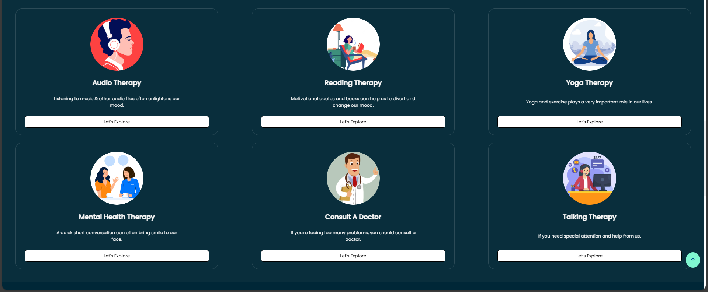
Implementation
Notes:
9

Slide 10
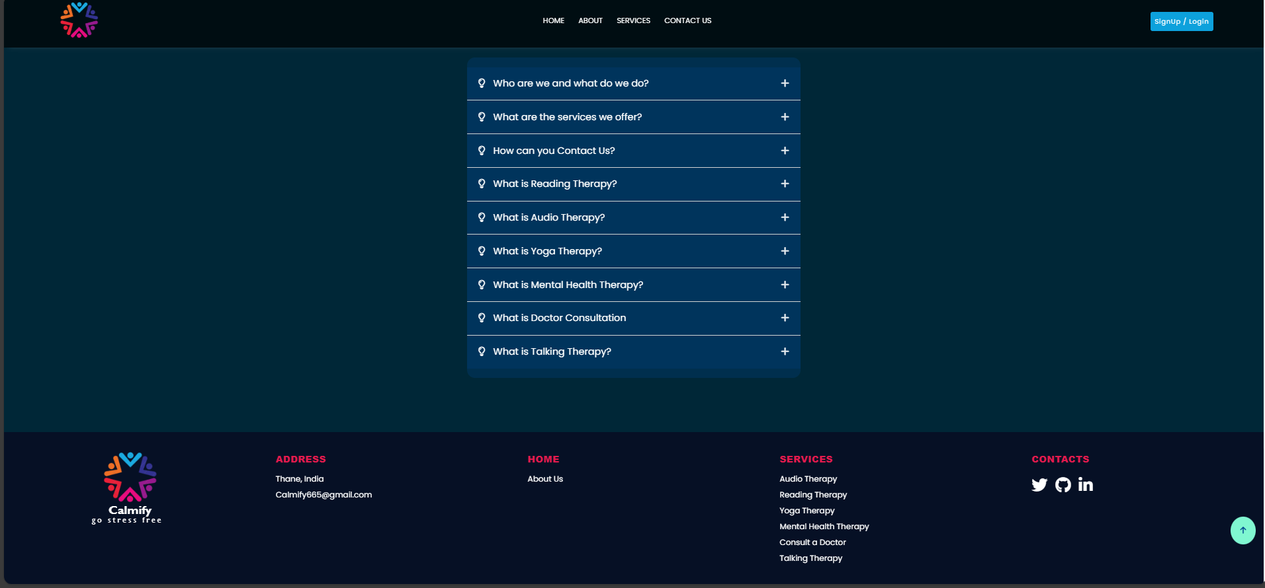

Slide 11
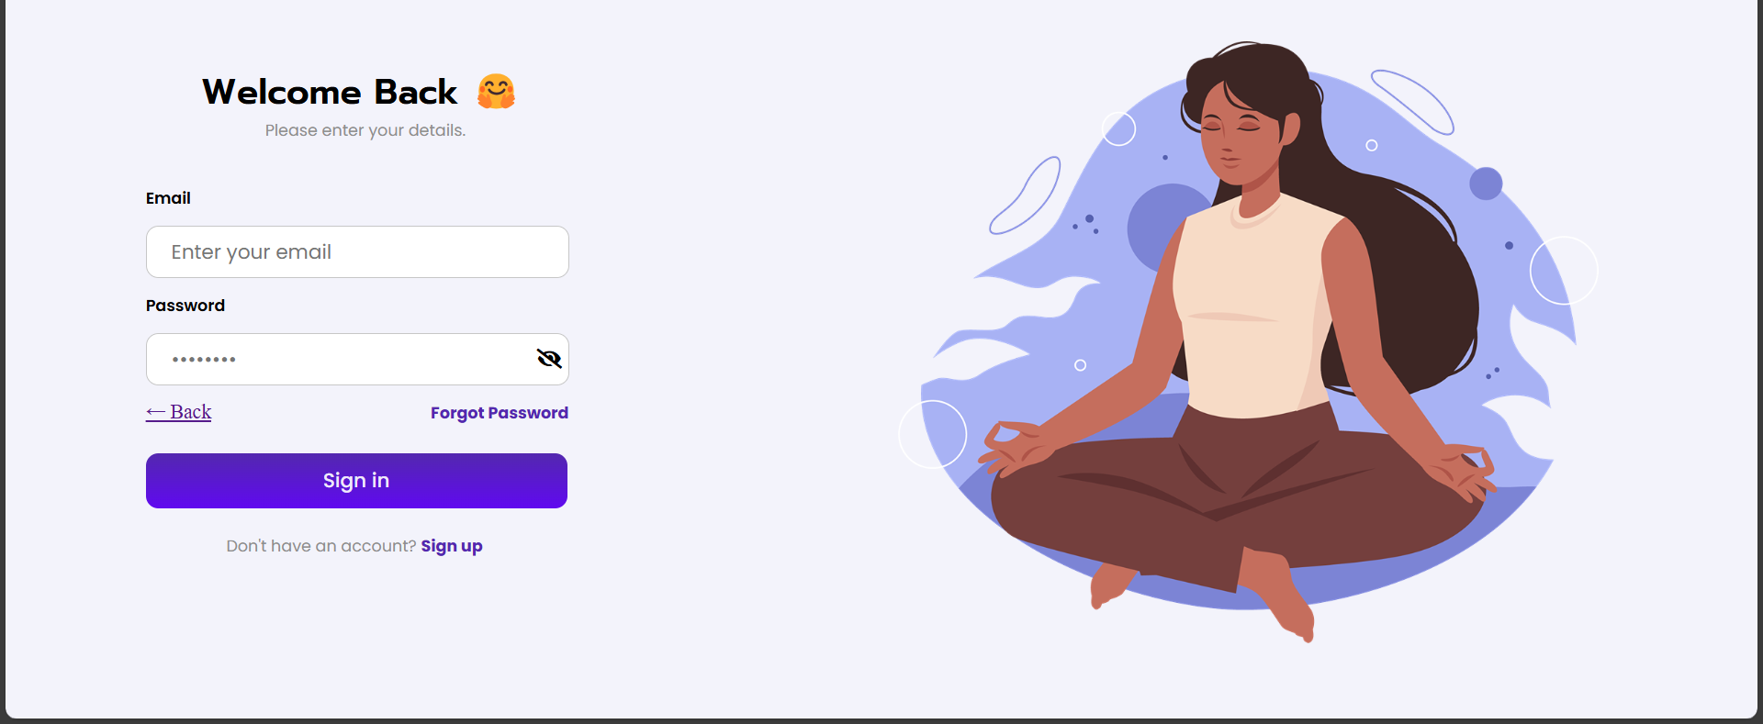
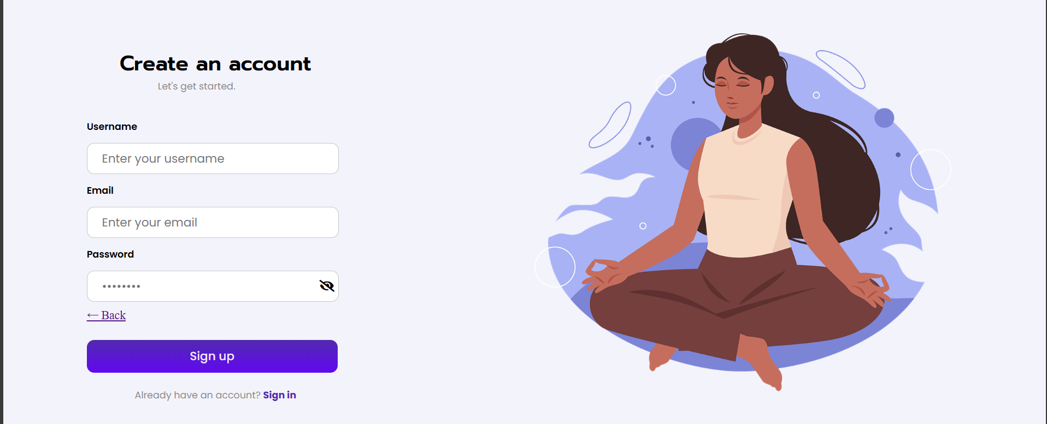

Slide 12
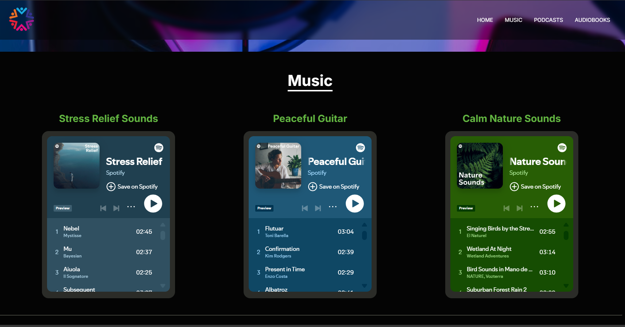
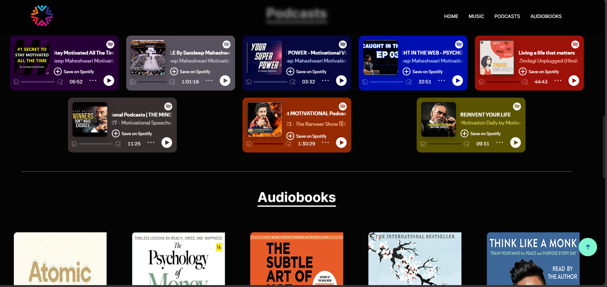

Slide 13
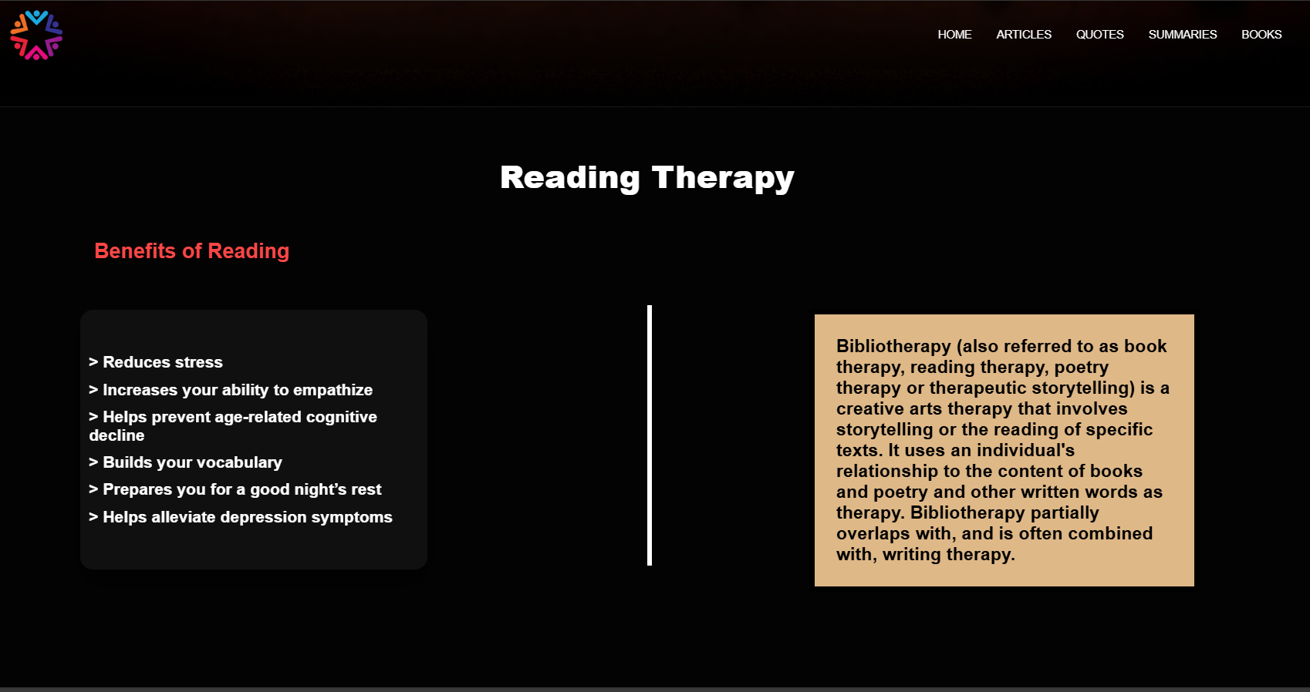
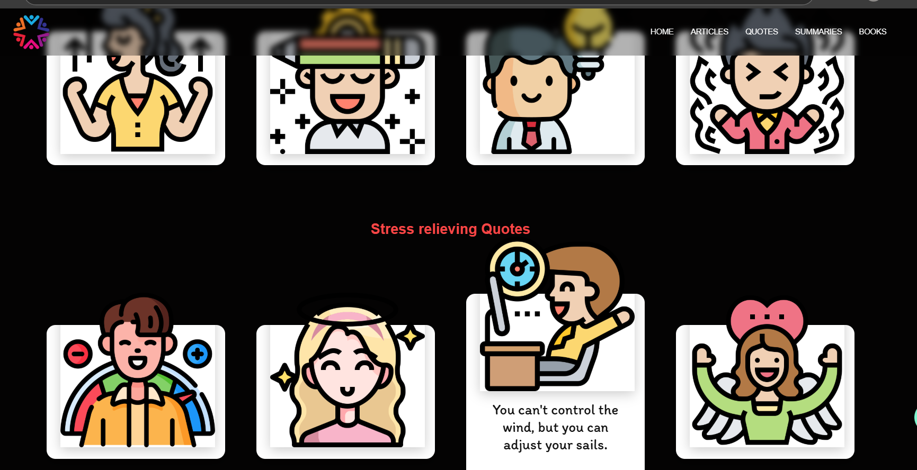

Slide 14
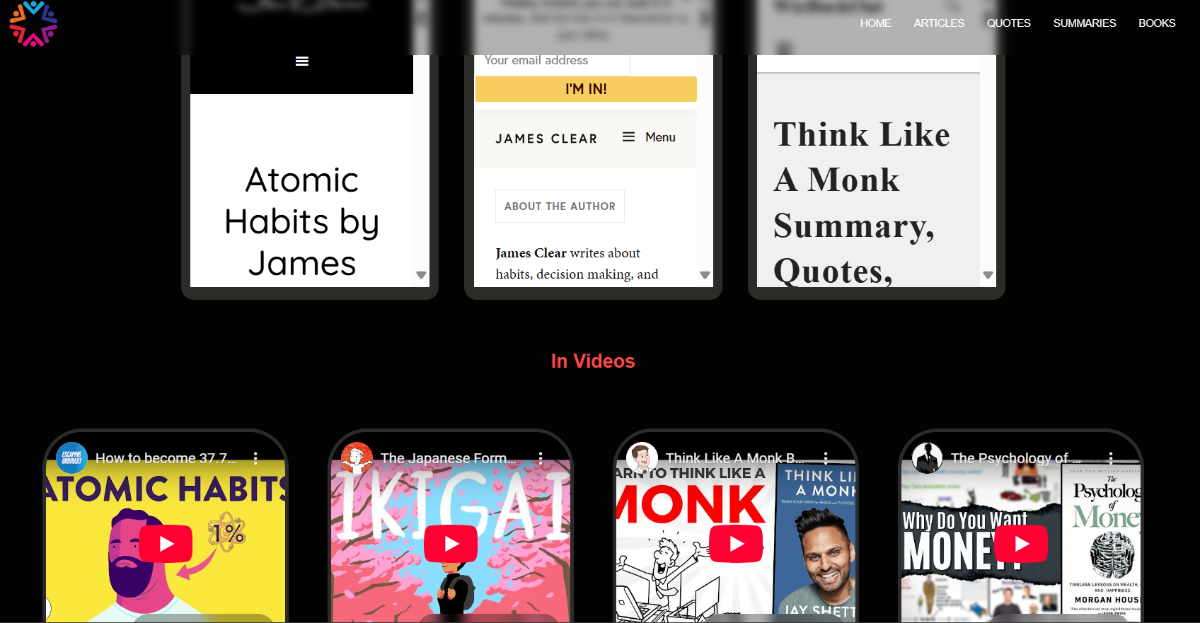
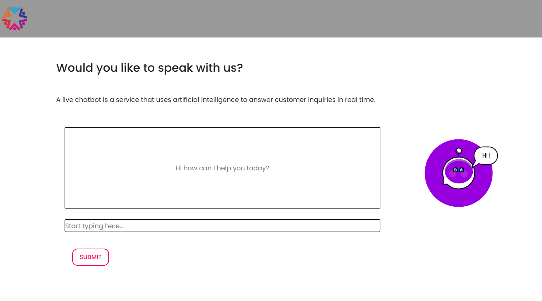

Slide 15
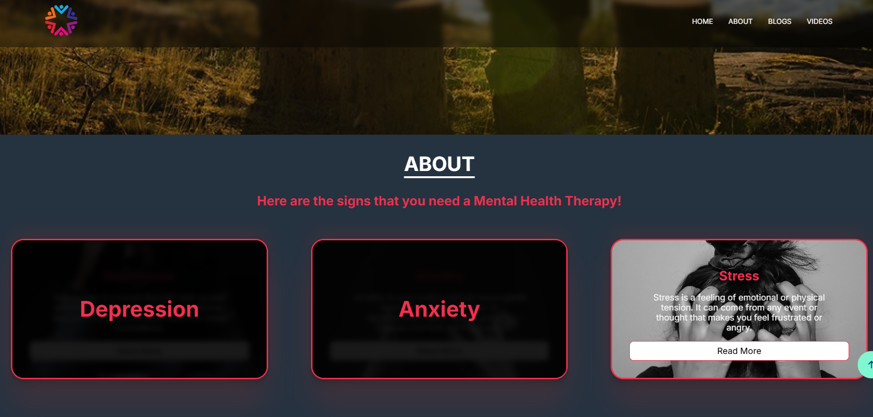
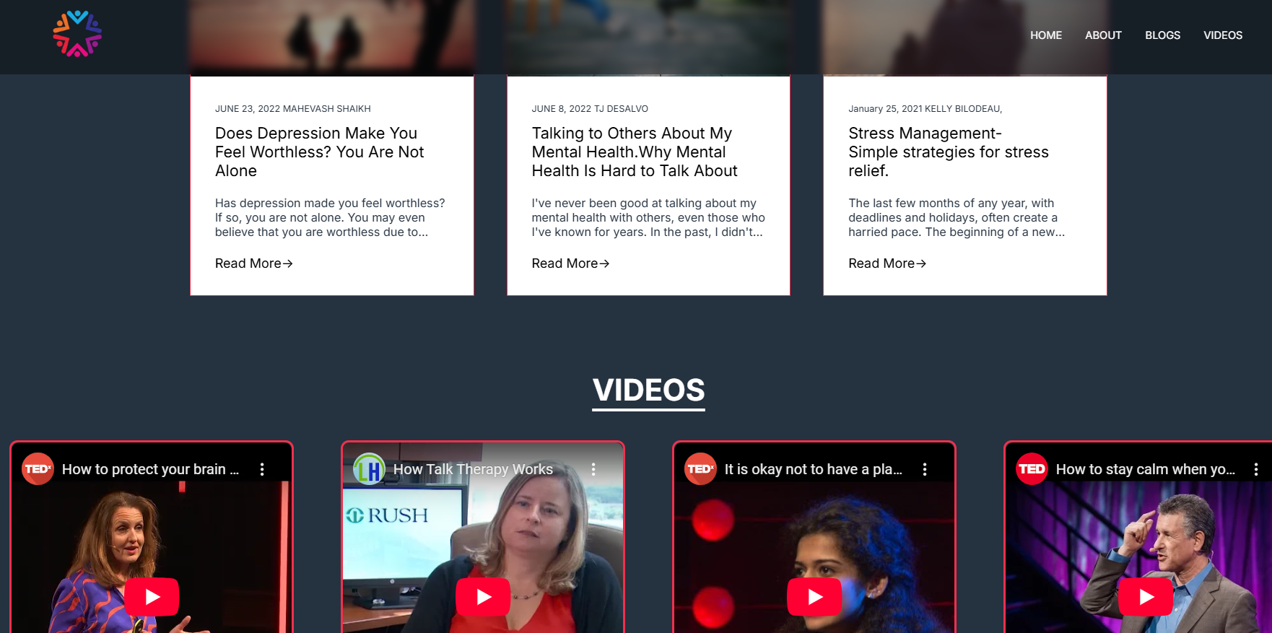

Slide 16
Conclusion
Calmify is a holistic stress-relief platform offering multiple therapy options like yoga, meditation, laughter, and professional consultations. It addresses gaps in existing mental health solutions by providing free, engaging, and accessible resources for users of all ages. The platform ensures a user-friendly experience through intuitive design and diverse content. With continuous updates and improvements, Calmify enhances mental well-being effectively.
Overall, it serves as a valuable tool for stress management and
emotional wellness.
Notes:
16

Slide 17
References
[1.] Schulz, Emily K.. 2021. "Managing Anxiety and Stress Holistically: Vedic Wisdom from the Purna Health Management System". Journal of Anxiety & Depression.
[2.] Jhaveri, D., McGonigal, A., Becker, Christel, Benoliel, J., Nandam, L., Soncin, Lisa-Dounia, Kotwas, I., Bernard, Christopher, and Bartolomei, F.. 2023. "Stress and Epilepsy: Towards Understanding of Neurobiological Mechanisms for Better Management".
[3.] Jimnez-Ocaa, Alvaro A., Pantoja, Andrs, Valderrama, Mario, and Giraldo, Luis Felipe. 2023. "A Systematic Review of Technology-Aided Stress Management Systems: Automatic Measurement, Detection and Control". Institute of Electrical and Electronics Engineers.
[4.] Anagnostou, M. and Drigas, Athanasios. 2022. "Mobile Applications for stress management". Federal University of Mato Grosso.
[5.] Børøsund, Elin, Varsi, Cecilie, Clark, Matthew M, Ehlers, Shawna L, Andrykowski, Michael A, Sleveland, Hilde Renate Sætre, Bergland, Anne, and Nes, Lise Solberg. 2019. "Pilot testing an app-based stress management intervention for cancer survivors". Translational Behavioral Medicine.
Notes:
17

Slide 18
Thank You...!!
Notes:
18

